Slide 1
From Surviving to Healing
Survivors + Allies Teach-In
May 9th, 2023
Co-Sponsored by the UCLA Center for the Study of Women|Streisand Center

Slide 2
Overview
1 | Welcome
2 | Who is Survivors + Allies?
3 | Campus Resources
4 | Demands & Study Findings
5 | What’s next?
6 | Group Visioning & Discussion

Slide 3
Who is Survivors + Allies?
S+A is a community and student-led collective organization that advocates for and with survivors of SV in the UC System

Slide 4
STudy Origins
February
FALL
April
May
Summer-FALL
2020
2020
2021
2021
2022
S+A begins informal meetings
We begin meeting with UCOP’s Systemwide Title IX Office
Begin series of meetings with UCLA Title IX’s Office, facilitated by VC Bradley
Launched the UC-wide survey
Continued meeting with UCOP Systemwide Title IX Office to share survey findings

Slide 5
preamble to Title IX of the
Education Amendments of 1972
“No person in the United States shall, on the basis of sex, be excluded from participation in, be denied the benefits of, or be subjected to discrimination under any education program or activity receiving federal financial assistance.”

Slide 6
What is Title IX and why doesn’t it prioritize healing?
Title IX is a federal law leading to procedural standards on university campuses. Title IX is a punitive system designed to address sexual and gender based violence through punishment.
There is no mental health resource built into the Title IX process. The investigative process, interactions with Title IX investigators who are not trauma-informed, and other aspects of the process has lead to re-traumatizing survivors.

Slide 7
Confidentiality
Some resources are confidential (e.g. CARE), meaning that they will not share information provided to them or file a legal report. Other resources are non-confidential (Title IX, TAs), and are mandated to file a report, which may or may not turn into an investigation..
Title IX coordinators can decide to open investigations without survivors’ consent.

Slide 8
Uc resources for survivors
Campus Assault Resources and Education (CARE)
Counseling and Psychological Services (CAPS)
Office of Ombuds Services
Student Legal Services
Title IX
LGBTQ Centers
Student Health Centers
Faculty and staff
Teaching Assistants
Sports Coaches
Non confidential | confidential

Slide 9
Surviving vs Healing: What might a new paradigm of survivor-centered resources look like?
Shifting frontline care from punitive systems (Title IX, UCPD) to healing-centered resources (CAPS, CARE)
Individualized resources for each person’s unique journey
Resources reflecting and tailored to student’s social identities (gender, sexuality, race/ethnicity, international student, etc)

Slide 10
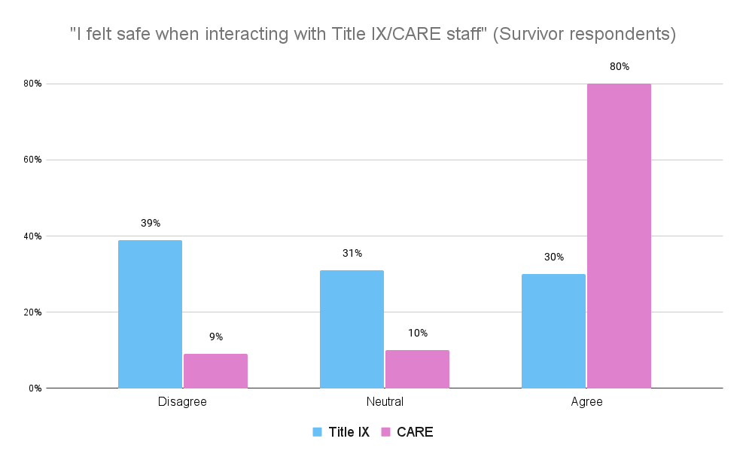
Demand 1: Increase CARE Funding

Slide 11
Demand 1: Increase CARE Funding
4
1
“They need more staffing. I feel like they are trying to do so much but operate on such small, under resourced teams. I've had experiences where it didn't felt I was the priority when I was meeting with them and they appeared to be thinking about all the other things on their plates.” -UCLA student
Title IX investigators at UCLA
Full-time CARE Advocate at UCLA
“It took so long to get an initial CARE office appointment. They were all booked for weeks and I was left with no resources. Once I finally met with them, it was great. But during the time in between, I had to seek significant outside help and did things detrimental to my academic success.” - UC Irvine student

Slide 12
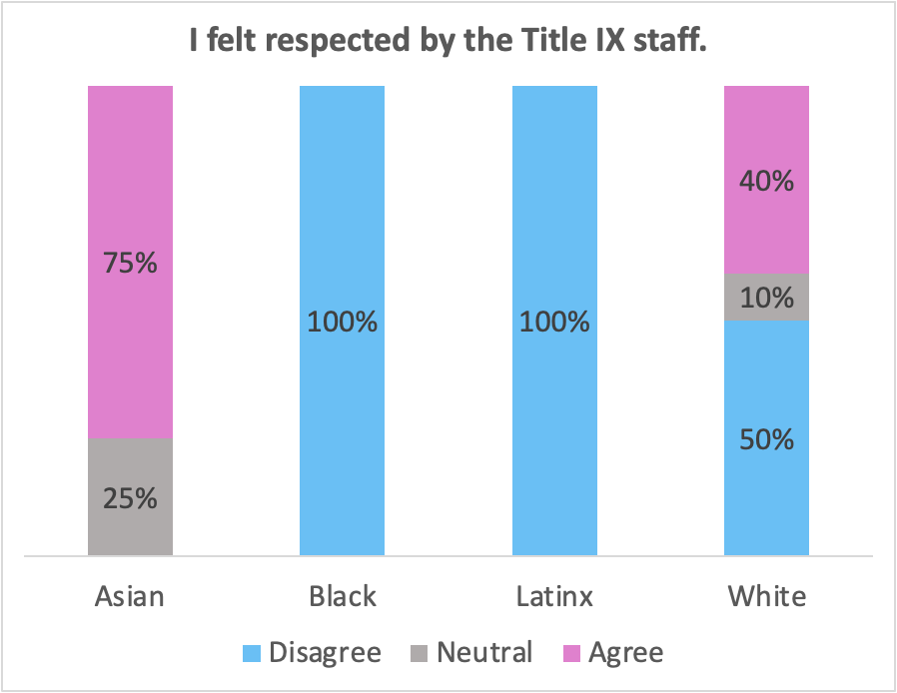
Demand 1a: provide A care advocate at all title ix intake meetings
83%
56%
Of survivors reported receiving clear information from CARE
Of survivors reported receiving clear information from Title IX

Slide 13
Experiences with care
“The CARE staff that I was connected to was very realistic (which is what I needed and wanted) and was very supportive; CARE staff made me feel listened and supported and I know that if I did go through further processes, they would have helped me a lot.”
UC Berkeley student
“My experience with CARE was so vital in my recovery. The doctors/counselors were so kind and held such a safe space. Everyone had the chance to talk.”
UC Santa Cruz student

Slide 14
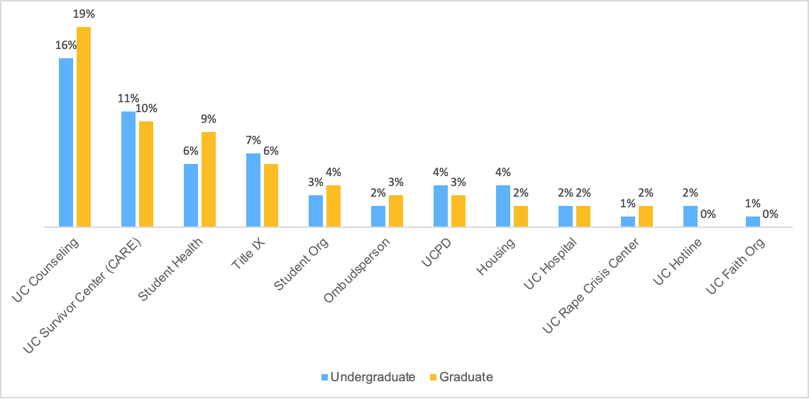
Demand 2: increase caps therapists and number of CAPS appointments in an academic year
UC Counseling (CAPS) was the most utilized on-campus resource for both undergraduate and graduate survivors, but students reported long wait times.

Slide 15
Demand 2: increase caps therapists and number of CAPS appointments in an academic year
“CAPS, I understand they are under funded and short-staffed, it still hurts individuals who really need help.” - UC Santa Barbara student
“CAPS is wonderful! If anything, they just need more funding to serve more students!” - UC Santa Cruz student
“I felt like my experience with CAPS was rushed due to the amount of appointments allotted per student. I discussed this with another friend at another UC who had similar concerns.” - UC Berkeley student

Slide 16
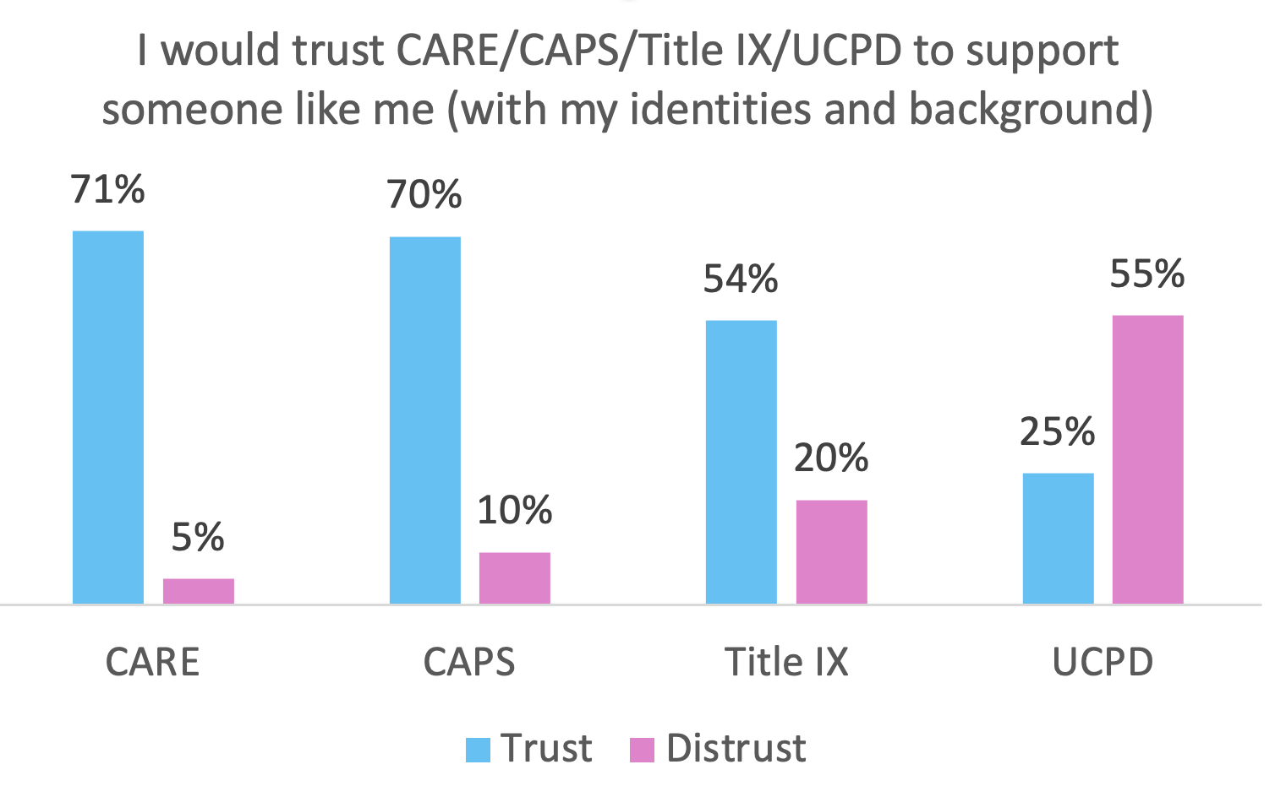
Demand 2a: hire therapists who share identities with marginalized student groups
*
* Survivor respondents only

Slide 17
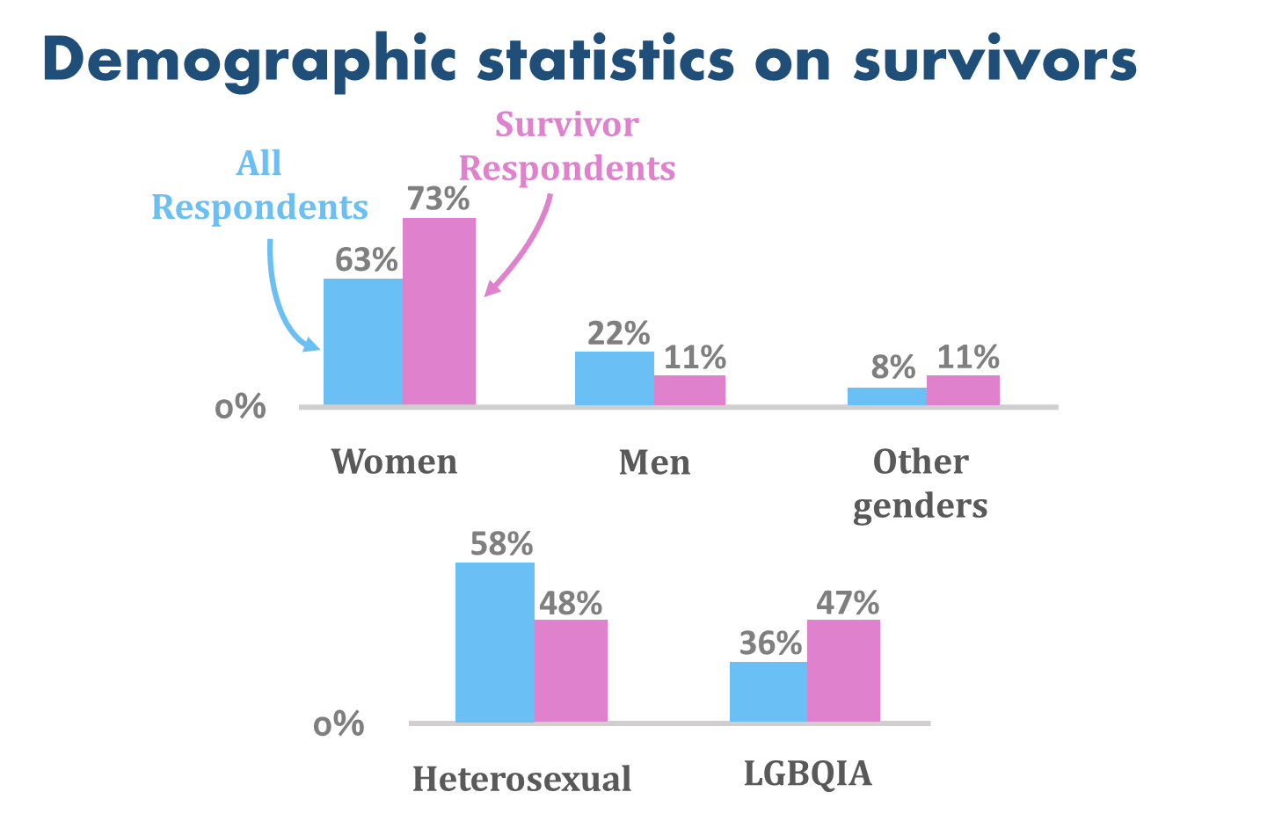
Demand 3: provide additional healing resources for students who may not feel safe with title ix or caps
“I've been looking for a support group focused on QTBIPOC women/femmes who are survivors of sexual abuse, assault, and gender-based violence”
- UC Santa Cruz student
"When race is not a factor in how sexual assault policy is written, there are few assurances to non-White students that they will interact with officials trained in anti-racist response practices in addition to anti-sexist ones" (Wooten, 2015).

Slide 18
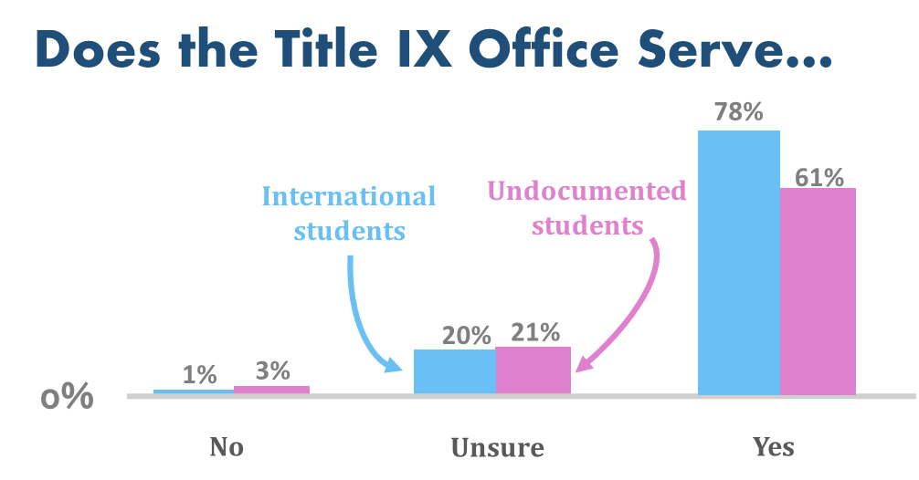
Demand 4: improve trainings and communications to clarify that all students are covered by title ix
12%
Of international students don’t know whether they are covered under Title IX

Slide 19
— UcLA international student
Feedback on the Title IX training:
“For international students, coming in to trainings of all kinds is just a bit hard; you've never heard of any of these things and aren't going to remember them well, so it all gets lost.”

Slide 20
Demand 4A: improve trainings and communications to clarify confidentiality

Slide 21
Student perspectives on the title ix training
36%
“The [Title IX] training I received didn't really differentiate what kinds of resources you would go to for addressing different needs around dealing with sexual violence (e.g. where to report, where to receive counseling, etc.)”
UC Irvine student
“Sending the resources after in a follow up email I think would help a lot in making me feel secure.”
UCLA student
“The Title IX training did not modify my understanding of campus resources. Everything I know about campus resources comes from the [non-Title IX training] orientation presentations when I first arrived.” -UC Irvine student
Of students believe the Title IX office is confidential (it is not)

Slide 22
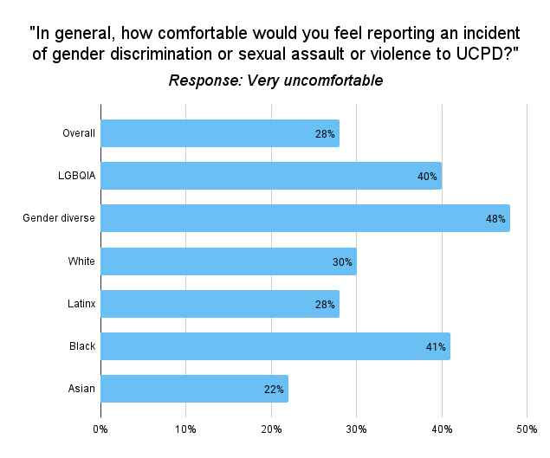
Demand 5: remove ucpd as a frontline resource for survivors
LGBQIA+ students are 40% less likely to report to UCPD than heterosexual students.
International students are 60% more likely to report to UCPD than non-international students.

Slide 23
Feedback on the police
“My interactions with the police only served to traumatize me further. Throughout the entire process I felt belittled, ignored, and disregarded. While I did receive an emergency protective order from the police upon my initial interaction with them, once my abuser was released on bail my interactions with them got less and less productive until they eventually ignored me. After a year, my case was ultimately rejected.”
UC Irvine student
“UCPD was the first university related place I came to after the stalking incident, but they didn't do anything until several more girls were harassed by the same man, and then he was kicked off campus. I wish they had done it sooner. After the initial call, he stalked me two more times.”
UC Riverside student

Slide 24
summary
1 | Increase CARE funding and provide CARE advocate at all Title IX intake meetings
2 | Increase CAPS therapists and hire more diverse therapists
3 | Provide additional healing resources for marginalized students
4 | Improve trainings and communications
5 | Remove UCPD as a frontline resource

Slide 25
What’s next for survivors + Allies
Public report and webinars
Academic publications
Policy work and advocacy
To continue sharing our survey findings more broadly and support other student groups with advocacy
To bridge gaps in the literature on international students, LGBQIA+ students, students of color, and research questions like the efficacy of Title IX trainings
Continuing to meet with policymakers to understand how legislation could further our goals at a UC systemwide, and California level

Slide 26
What can you do?
Use our syllabi statement (on UC Speaks Up website)
Support other organizations doing this work
Bruin Consent Coalition, UC Speaks Up study, Center for the Study of Women, UC Global Health Institute
Sign our demand letter to Title IX to stop collecting sensitive data on survivors through Title IX trainings

Slide 27
Group discussion: how do we get to a new paradigm of survivor-centered healing?

